Slide 1
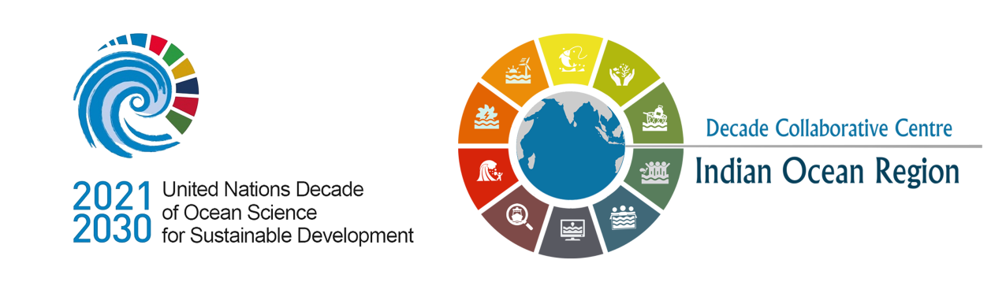


Overview of INCOIS activities & Ocean Information System at INCOIS
OTGA-INCOIS Training Course on "Coastal Vulnerability Mapping and analysis using QGIS
24-29 November 2024
Indian National Centre for Ocean Information Services (INCOIS), Hyderabad

Slide 2

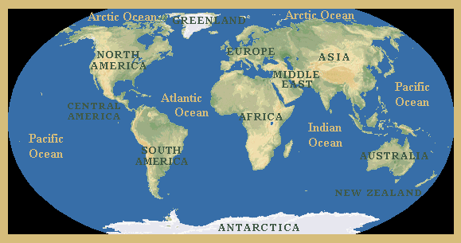
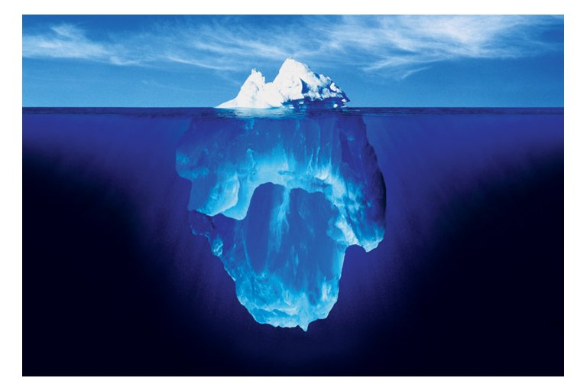
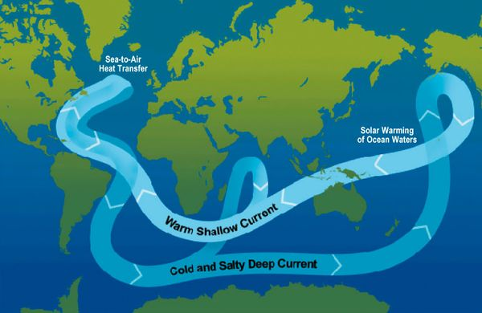
Oceans
Facts about ocean
Around 70% of the Earth’s surface is covered by oceans.
Oceans contain 97% of the Earth's water.
The largest ocean on Earth is the Pacific Ocean, it covers around 30% of the Earth’s surface.
The deepest part of the oceans is the Mariana Trench (Depth 11.1 km).
Even if Mount Everest (height 8.85 km) is submerged in Mariana trench, there would still be a column of nearly 2.2 km of water above it.
The Indian Ocean is the third largest ocean on Earth, it covers around 14% of the Earth’s surface.
Huge oceans are formed due to separation of continents from one another by spreading of sea-floor
Though generally recognized as several 'separate' oceans, these waters comprise one global, interconnected body of salt water (referred to as the global ocean)

Slide 3
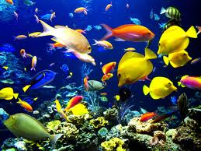
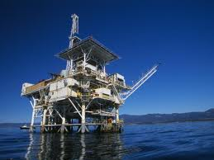
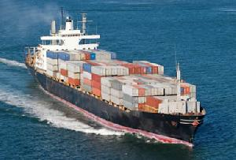
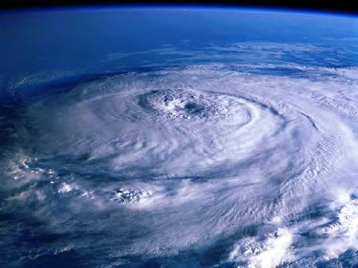
Oceans
Why Oceans are important?
Biodiversity: Coral reefs, Salt marshes, Estuaries & Mangroves and Seagrass beds are few ocean environments which support large no. of different species of organisms.
Natural Resources: The continental shelves and ocean floor are home to many important minerals including oil and natural gas.
Transportation: Ships and barges used for transportation of heavy goods from place to place.
Climate and Weather: Oceans control the atmosphere and global climate. Ocean currents transport large amounts of heat and water around the world and interact with atmosphere intern effecting the climate change.
Socio Economy: 66% of World’s population lives within 100 km of the coastline. Revenue related to ocean is generated through: fishing, mining, shipping, biomedical products etc.
Regulate Earth system: Ocean is the number one producer of Oxygen, as a result of the Algae.

Slide 4
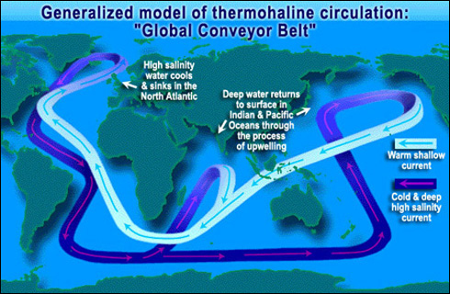
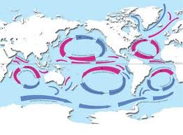
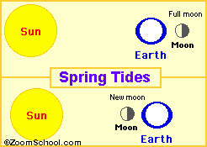
Ocean Processes
Ocean Circulation:
Ocean circulation is the large scale movement of waters in the ocean basins.
Winds drive surface circulation, and the cooling and sinking of waters in the polar regions drive deep circulation.
Ocean Currents:
The water of the ocean surface moves in a regular pattern called surface ocean currents.
Ocean currents may be driven by tides, winds or differences in density.
Ocean Waves:
The winds cause waves on the surface of the ocean (and on lakes).
The wind transfers some of its energy to the water, through friction between the air molecules and the water molecules. Stronger winds (like storm surges) cause larger waves.
Tides: Tides are the rise and fall of sea levels caused by the combined effects of the gravitational forces exerted by the moon and the sun and the rotation of the Earth

Slide 5
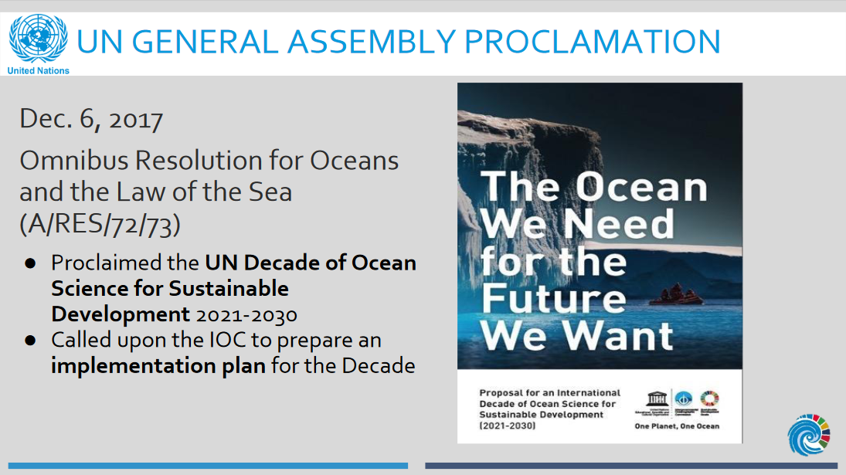

Slide 6
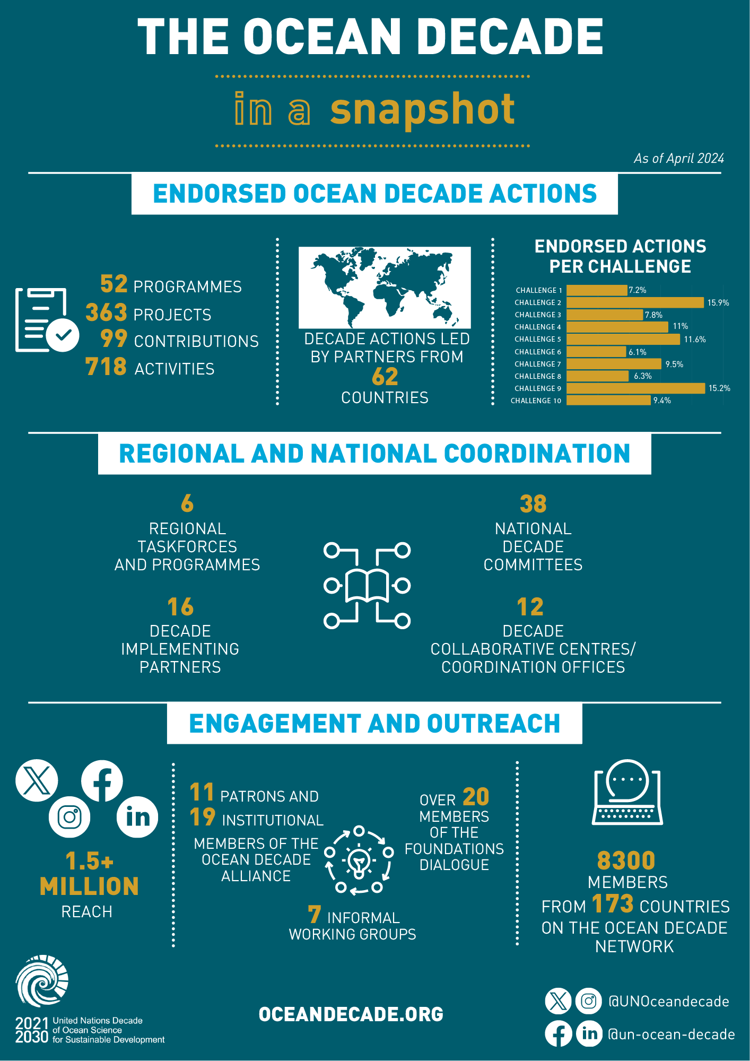
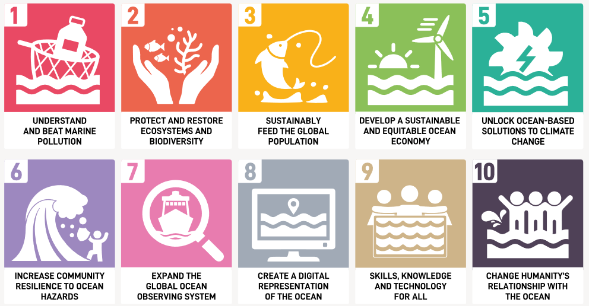
Ocean Decade : An overview
Ocean Decade Outcomes
Clean Ocean
Healthy and resilient Ocean Productive Ocean
Predicted Ocean
Safe Ocean
Accessible Ocean
Inspiring and engaging Ocean

Slide 7
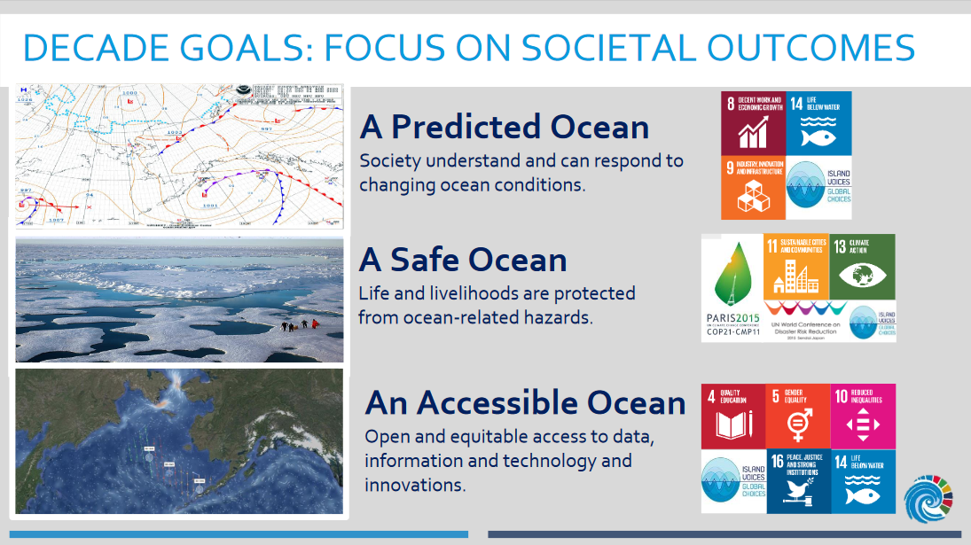

Slide 8
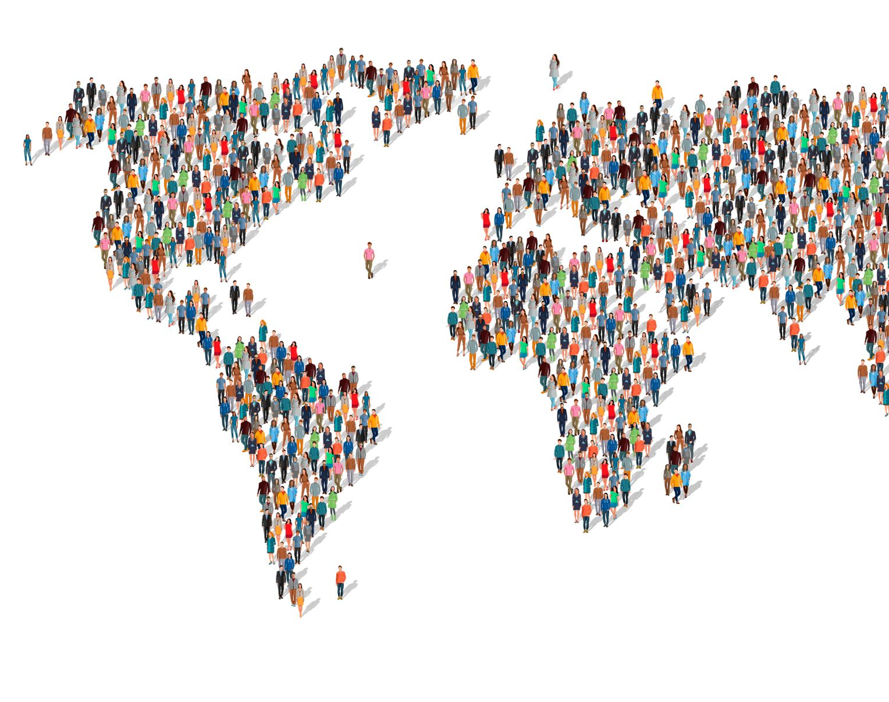
International Activities

Slide 9
INCOIS International Interface
IOGOOS
Coastal Projects
Modelling
Remote Sensing
IORP
SIBER
IRF
IndOOS (RAMA)
Remote Sensing
Modelling
In-situ
IIOE-2
UN Ocean Decade
IOC, IOGOOS & SCOR co-chairs
India / INCOIS is Chair of IOGOOS
International Programmes
DCC for Indian Ocean Region (DCC-IOR)
POGO
Hosts:
IOGOOS Secretariat
SIBER International Project Office
IIOE-2 Program Office
Tsunami Warning (Regional Operations)
ICG/IOTWS
Bilateral Arrangements
RIMES
OceanPrediction DCC
Coast Predict
Ocean Data
NODC (IODE/IOC)
Regional DC
OceanSites (JCOMM)
ARGO
National DC
GEOS
WMO-IOC JCB
WMO RSMC for NWP & OWP
ITCOOcean
G20 Climate Sustainability WG

Slide 10
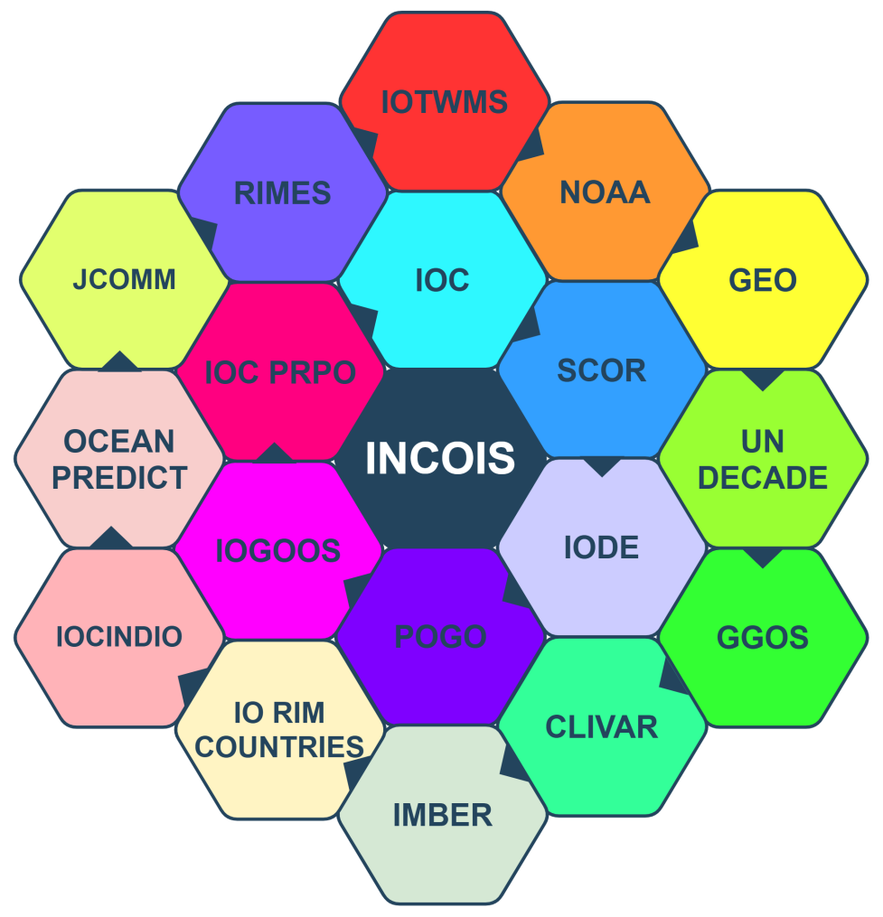
IOC Regional Committee for the Central Indian Ocean (IOCINDIO)
GOOS-GCOS-WCRP Ocean Observations Physics and Climate Panel (OOPC)
Argo Steering Team
Regional Integrated Multi-Hazard Early Warning System for Asia and Africa (RIMES)
Ship Observing Team (SOT)/JCOMM
Waves In Shallow Environment (WISE)
Coordinated Wave Climate Program (COWCLIP)
DBCP – Wave Observations TTM
GNSS Augmentation for Tsunami Warning of Global Geodetic Observing System (GGOS)
Disaster Risk Reduction Working Group (DRR-WG) of Group of Earth Observations (GEO)
Expert Team on Operational Ocean Forecast Systems (ETOOFS)
World Meteorological Organization (WMO) Expert Team on Met ocean Requirements (ET-MOR)
IA with NOAA on Wave modelling and Fisheries
Bio Argo Steering Committee
World Meteorological Organisation (WMO) – Intergovernmental Oceanographic Commission (IOC) Joint Collaborative Board
GOOS and GOOS Steering Committee
Memberships at Individual / Team / Organisation Level

Slide 11

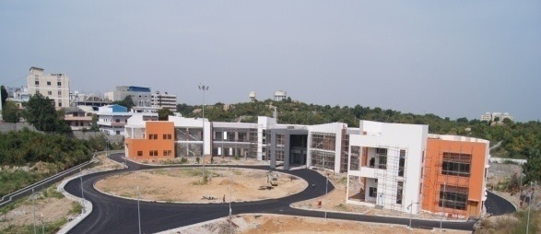
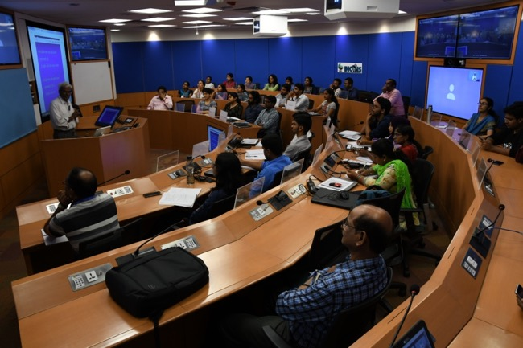
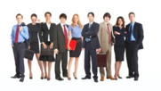
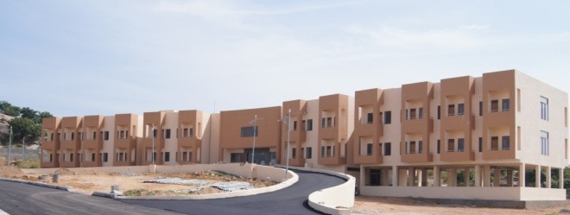

Capacity Development
6500
people trained from 95 IOC Member States
103
training courses:
English
Duration (days to weeks)
Themes covered:
Ocean Observations, Data Management & Visualization
Ocean Modelling and Operational Ocean Services
Water Quality, Harmful Algal Blooms, Ocean Acidification
Tsunami & Storm Surges, Multi Hazard Vulnerability, Shore line changes.

Slide 12
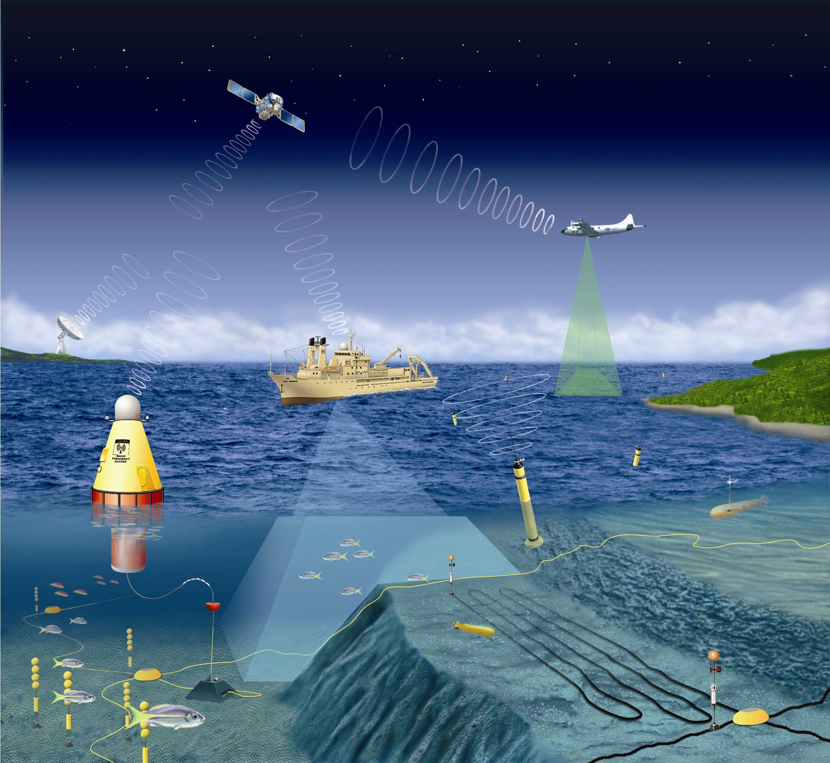
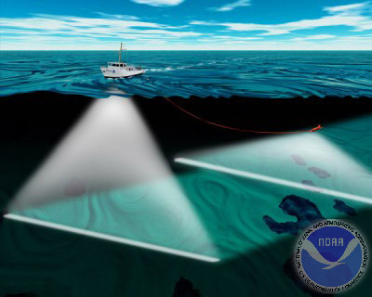
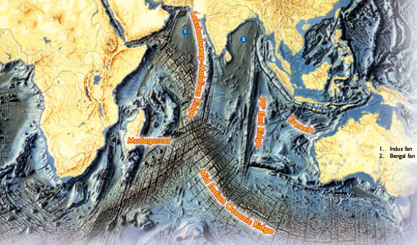
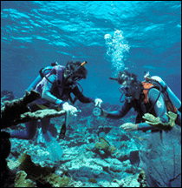
Ocean Observation Systems
Satellite
Scientists study Oceans using various observation platforms
Satellites, Buoys, Argos, Research vessels, Side-scan Sonars, under water robots etc.
Aircraft
Ship
Buoy
Sea Floor
Argo
Under water Glider
Sea Floor

Slide 13
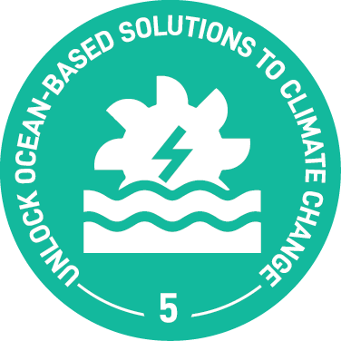

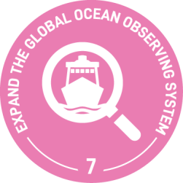
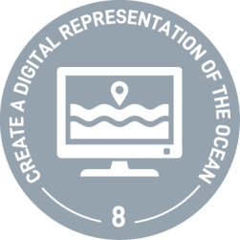
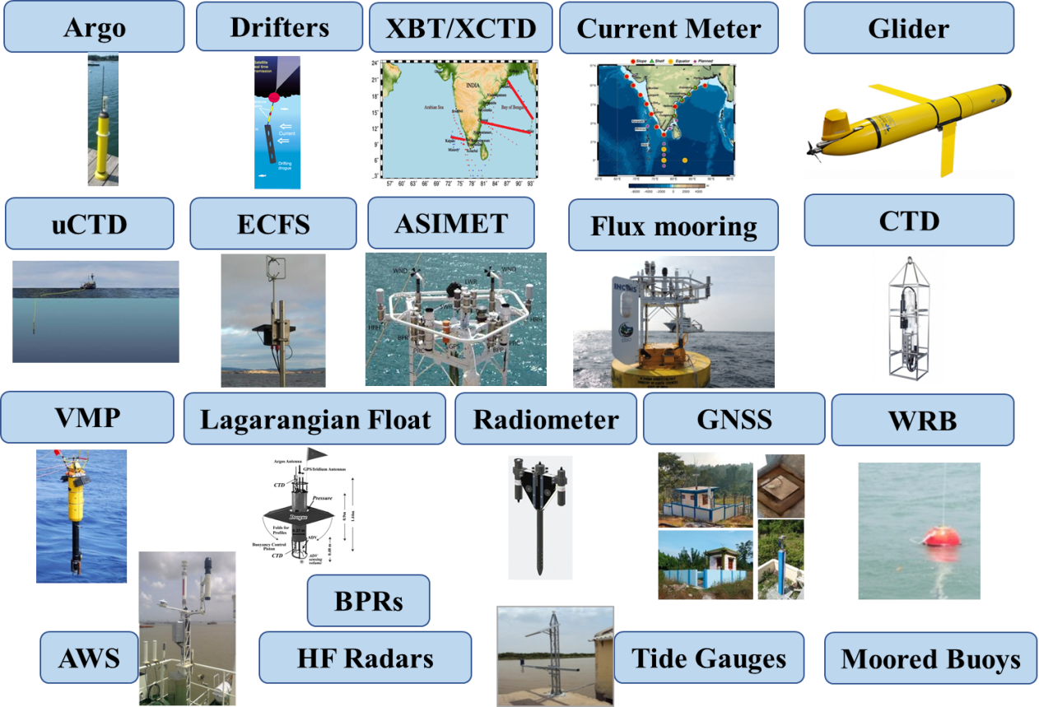
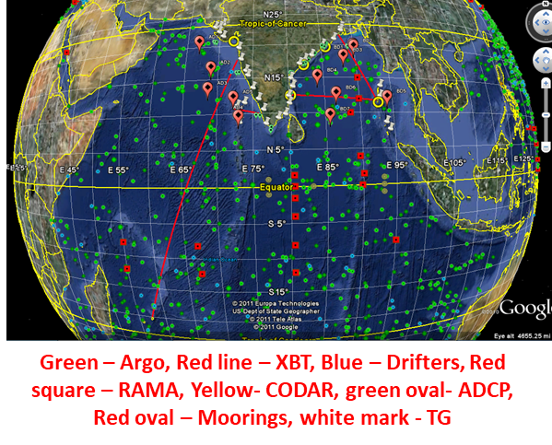
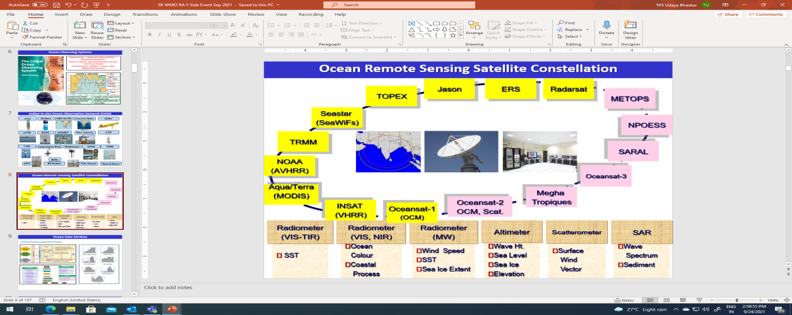
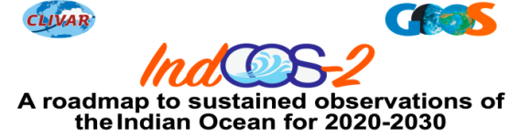
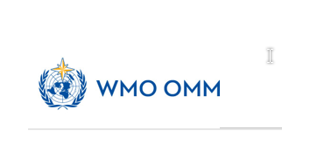
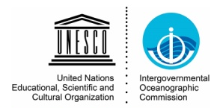
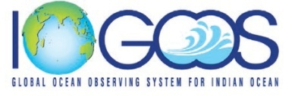
Ocean Observation Network of India
Global Design (GOOS) -> Regional Implementation (IndOOS) -> National Contributions (INCOIS & NIOT OOS, IMD Weather Watch)
Themes: Climate, Operational Ocean Services, and Ocean Health
Essential Ocean Variables: Physics, BGC, Biology & Ecosystems, Atmosphere

Slide 14
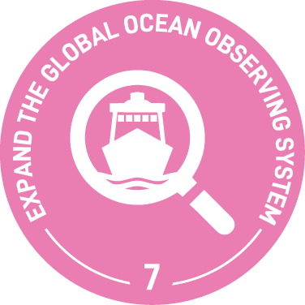
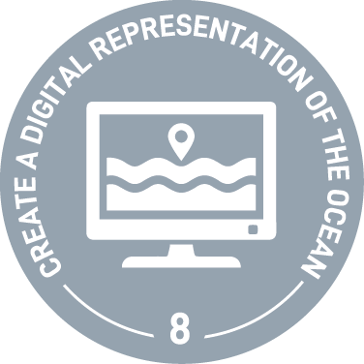
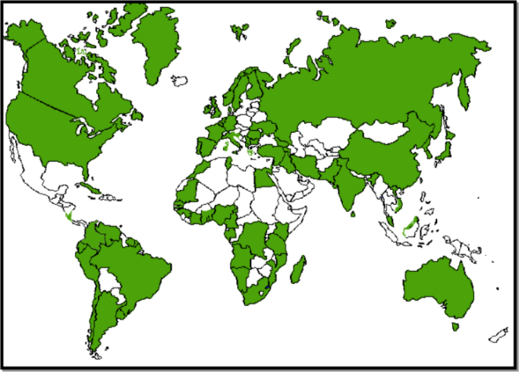
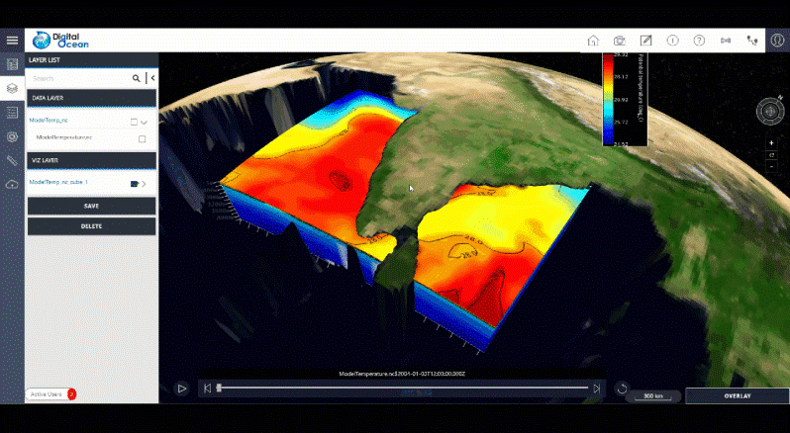
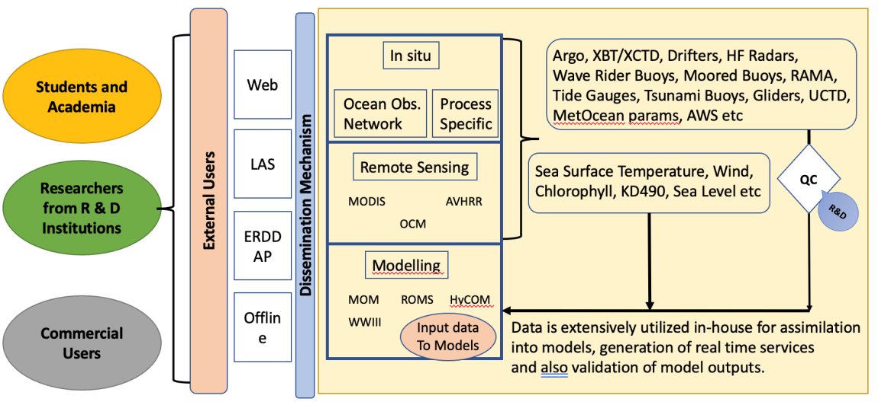
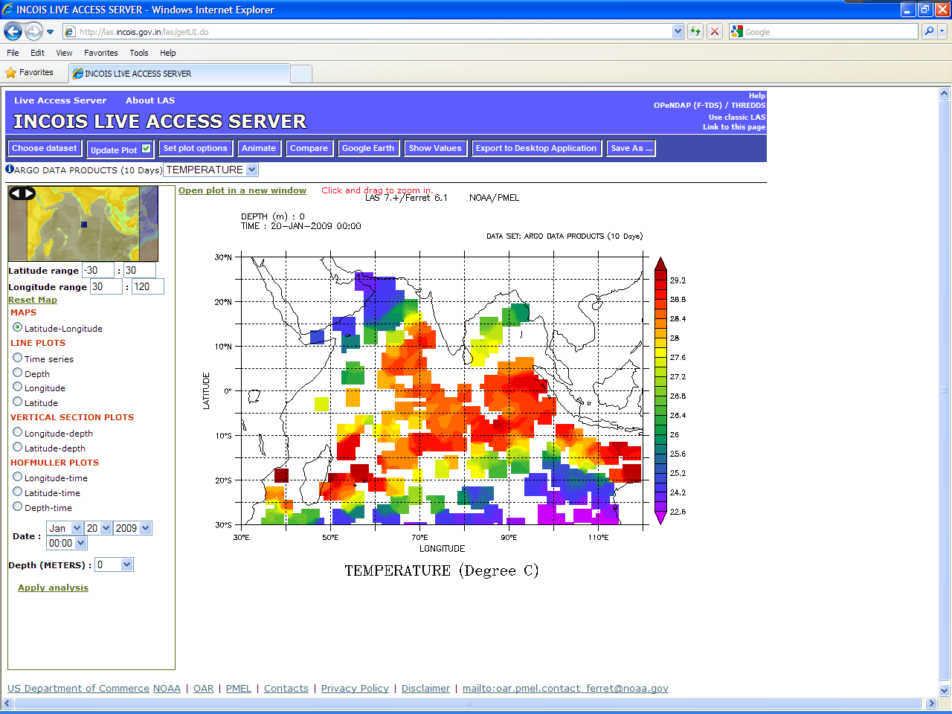
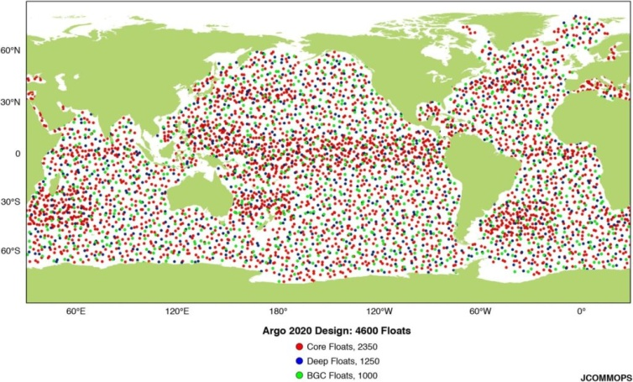
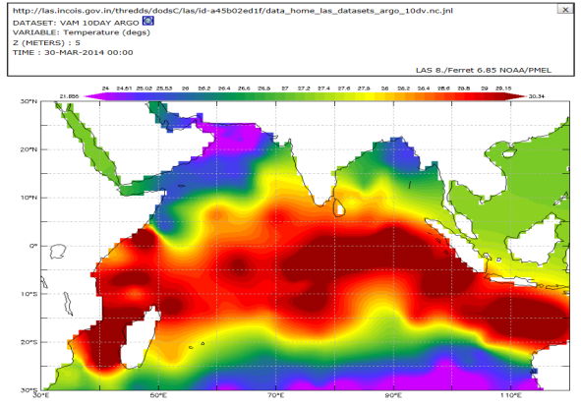
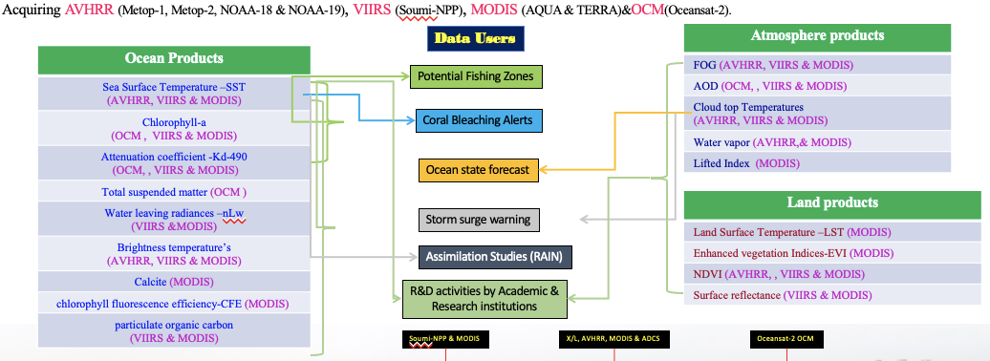

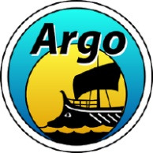
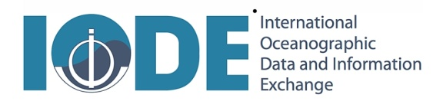
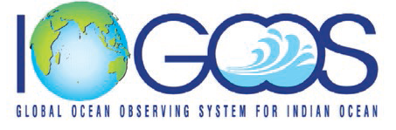
Digital Ocean
Accreditation
Data Dissemination
Data Management
NODCs
Argo Regional Centre

Slide 15
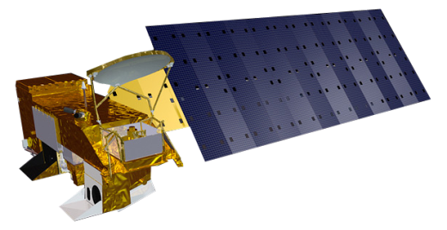


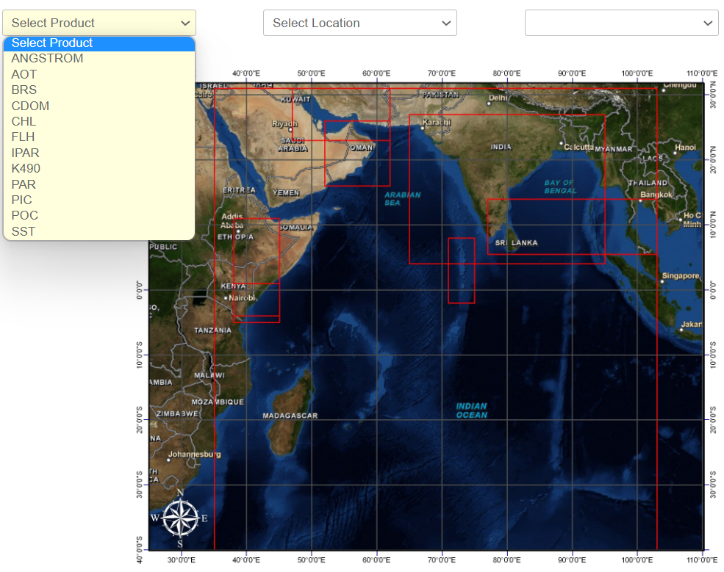

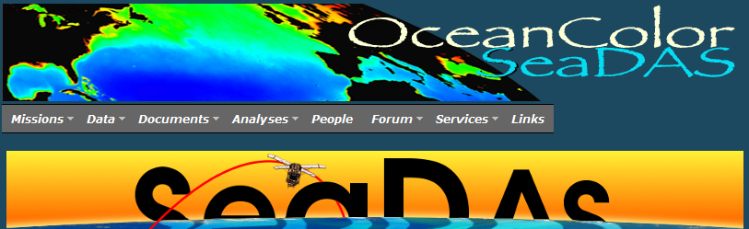



Near-real time satellite data dissemination for IOR countries
MODIS-Aqua satellite
https://incois.gov.in/portal/ChloroGIN

Slide 16








Modelling and Prediction Systems
INCOIS Ocean Modeling
and Data Assimilation
Activities
INCOIS Ocean Modeling
and Data Assimilation
Activities
Ocean Circulation Modelling
Monsoon Forecast
(CFS model)
Ocean Analysis (GODAS)
Tropical Cyclone
Heat Potential
Ocean Modeling Mission
Estuary
Coastal
Cyclone Prediction
Deep Ocean Mission
Climate Indices
Data Assimilation (LETKF, 3DVAR, OI)
Monsoon Mission
Regional
Coastal Water Quality
Monitoring and Forecast
Program
Global
Regional Analysis
Circulation Models (ROMS, MOM, HYCOM)
Ocean Predict
(GODAE Ocean View)
Wave, Tsunami and
Storm Surge Modeling
Regional and
Coastal Forecasts
Value Added Services
(OOSA, SARAT)
Wave,
Tsunami, Cyclone,
Storm Surge
(Wavewatch III
ADCIRC, SWAN,
HWRF+HYCOM)
Model simulated variability of Temperature
Satellite validation
Forecast and
Advisory services
Satellite: Model Forcing-Validation-Data Assimilation

Slide 17

Ecosystem Services

Slide 18




Ecosystem Services: Potential Fishing Zone (PFZ) Advisory Services
Less Catch & Profit
Higher Search Time
More Fuel
Increased
C0₂ emission
Huge Effort
Without PFZ Advisories
2-4 times Higher Catch & Profit
30- 70 % reduction in Search Time
Savings range from 21.47 lt to 1293.53 lt
Reduction Ranges from 3.45 t to 0.06 t
Direct Navigation to Shoal
With PFZ Advisories
Recognized by the International Community as a matured operational application of satellite remote sensing for providing timely and reliable advisories to fishermen

Slide 19







Ecosystem Services: Algal Bloom Information Service (ABIS)
Inaugurated on 24 Feb 2020
Data generated for India and Sri Lanka
Monitoring the four hot-spots in Indian Ocean
NAS, Kochi, Gulf of Mannar, Gopalpur
Satellite products: Chl-a, SST, BI, Chl anomaly, SST anomaly, Spread of Green, red noctiluca and diatom, phytoplankton size class
https://incois.gov.in/portal/hab_products.jsp#Latest
Status | Condition | Color Code
Normal | Bloom pixels < 50%
Watch | Bloom pixels ≥50% and < 75%
Warning | Bloom pixels ≥ 75%
Chl-a > 1 mg-m⁻³ , SST < 27.5°C, BI > -0.6
The presence of green / red noctiluca / diatom
Notes:
The increasing frequency of algal bloom is a major concern due to its ill effects on fishery, marine life and water quality. INCOIS has developed a service for "Detection and Monitoring of Bloom in the Indian Seas". The targeted users are fishermen, fishery resource managers, researchers, ecologists and environmentalists. The bloom information also complements the Potential Fishing Zone advisories.
INCOIS Algal Bloom Information service was officially inaugurated on 24 February 2020 and provides near real time information on the presence of bloom in the north Indian Ocean. The satellite derived SST, Chlorophyll, and a derived parameter called Bloom Index are used to provide the Algal Bloom Information service. Together with the Algal Bloom Information Phytoplankton species and size information are also will be provided.
Right now, INCOIS is constantly monitoring the four bloom hotspots in the Northeastern Arabian Sea, coastal waters of Kerala, Gulf of Mannar and the coastal waters of Gopalpur.
If the bloom is due to the presence of green or red Noctiluca then the bloom is classified as harmful. If the bloom is dominated by diatoms, then that is classified as non-harmful.
The area is designated under ‘WATCH’ if the sector has more than 50% bloom pixels. If the area has more than 75% bloom pixels, then that sector is put under ‘WARNING’. The status of each sector is displayed by color code (green for normal, yellow for watch & red for warning).

Slide 20





Ecosystem Services: Coral Bleaching
Distribution of Coral reefs near Indian coast:
Bleaching event during the April-May 2016
at Andaman
Service initiated since Feb 2011 and 122 advisories provided every year
Notes:
Coral reefs are diverse underwater ecosystems held together by calcium carbonate structures (Coral polyp) secreted by corals. Coral reefs are beautiful, colorful and the cornerstone of a healthy ocean ecosystem.
Corals are animals, even though they may exhibit some of the characteristics of plants and are often mistaken for rocks.
Often called "rainforests of the Ocean/sea," shallow coral reefs form some of the most diverse ecosystems on Earth. Coral reefs provide complex, three-dimensional habitat for a huge variety of plants and animals (large and small!), and protect many young fish species as they grow
Coral reefs only occupy 0.1% of the area of the ocean but they support 25% of all marine species on the planet.

Slide 21




Ecosystem Services: Marine Heatwaves
Methodology
SST overlay on 90th Percentile of Threshold
Marine Heat Wave Alert categories
Notes:
MHW is the discrete prolonged anomalously warm water event. Here use daily optimum interpolated SST(OISST) with 0.25 degree spatial resolution. INCOIS proposed disseminate MHW advisory over INDIAN OCEAN (45 S to 30 N & 15E to 120 E) including south chain sea. Products: spread MHW Area in basin scale including Indian state wise sector, Severity of MHW category, duration of MHW and its impact on different Ecosystem: PFZ, CORAL, HAB, Seagrass, Algae etc

Slide 22


Ecosystem Services: Water Quality
Parameters: Temperature, Salinity, CDOM, Nitrate, Nitrite, Phosphate, silicate, Oxygen, Oxyge saturation, Alkalinity, Scattering coefficients, pH etc
Products:
validation and forcing of water quality parameters for Ocean modeling and data assimilation, monitoring of Harmful Algal bloom, coastal pollution monitoring etc

Slide 23

Multi Hazard Services

Slide 24





Disaster Related Services: Tsunami Early Warning
Indian Tsunami Early Warning Centre
Regional Tsunami Early Warning Services

Slide 25






Tsunamigenic zones and Advisory Mechanism
Tsunami Travel Times & Response time
Makran Subduction zone, Travel Time to nearest Indian Coast (Gujarat) are 2 to 3 hrs
Nicobar Islands , travel times to nearest coast (A&N Islands) are 20 to 30 min
For Indian mainland 2 to 3 hrs

Slide 26

UN Ocean Decade 2021-30 & Ocean Decade Tsunami Programme
UN Ocean Decade (2021-30): Once-in-a-generation opportunity to achieve “transformational gains” in tsunami warning and mitigation system by addressing gaps in tsunami warning and enhancing community preparedness.
IOC Assembly 31 in June 2021 (Dec. A-31/3.4.1) established the “Ocean Decade Tsunami Programme” and “Scientific Committee” to Develop Research, Development & Implementation Plan
Technological & Observational Advances to reduce uncertainties in tsunami warning
100 % at risk communities prepared & resilient to tsunamis by 2030 (Tsunami Ready, etc.)
Contributing to “A Safe, Predicted and Accessible Ocean” Decade Outcomes via Challenge 6 on “Multihazard Early Warning Services & Community resilience” and Challenge 9 on “Capacity Development” and aligns with all three Decade Objectives related to Identification, Gerneration and use of knowledge for Sustainable development. Directly supports SDG 11 by applying advancements to Ocean Science to saving lives and reducing number of affected people and economic losses in coastal cities and communities.
IIOE-2

Slide 27

Tsunami Early Warning Services for Indican Ocean Countries
In October 2011, Indian Tsunami Early Warning Centre (ITEWC), INCOIS recognized as a Tsunami advisory Service Provider (TSP) along with other two TSPs of Australia and Indonesia by IOC-UNESCO. Since then ITEWC providing tsunami services to all Indian Ocean member countries.
INCOIS is providing tsunami services to 25 countries in the Indian Ocean Region.

Slide 28


Ocean State Forecast Services
Ocean State Forecasts
45 User specified daily forecast products for India
and 06 Neighbouring Countries
3-5 Day Forecasts of Ocean State
High Wave/swell/bulletins
Joint INCOIS – IMD Bulletins including storm surge
Bulletins on Ocean State Forecast along Standard shipping routes
OSF for Ports & Harbours
OSF for Shipping
OSF For Navy
OSF for Oil & Gas E&P
Online Oil spill advisories (OOSA)
Search and Rescue Aid Tool (SARAT)
Small Vessel Advisory System
Notes:
28

Slide 29






Marine Safety Services: Swell Surge Alert
Peak Wave Period
Peak Wave Period
Kozhikode – buoy observation/models
Peak Wave Period
Seychelles – buoy observation/models
Numerical wave model
swell period output (above)
10 Year Envisat Advanced Synthetic Aperture Radar Indicate the regions of dangerous crossing swell (right)
Swell waves damage Kerala coast
Notes:
29

Slide 30
























Swell Surge Warning/Alert
Swell Surge happened on 31 March 2024 at a few coastal places of Southern India. High swell wave experienced Kerala.
INCOIS issued Rough Sea/Swell surge Alerts to the respective states/UTs on 29, 30 & 31 Mar2024.
INCOIS team surveyed the impacted areas in Kerala and observed 120 m max. inundation at Adimalatura, and 1.2 m max wave height at Pozhiyoor.
INCOIS issued Swell surge Warning to Kerala, South Tamil Nadu and Lakshadweep, and Alerts to remaining Indian coastal states on 04 & 05 May 2024. About 1.02 cr. SMS disseminated through CAP.
Swell surges experienced low-lying areas Kerala and TN. As per report from Kerala, low-lying areas got flooded and damages were reported at few scattered coastal districts.
From WRB and MRB observations, it was evident that swell periods 20-25 sec and swell height 1.2-2.8 m as forecasted by models.
This was a success story of INCOIS as we could monitor the oceanic conditions through observations/models and forewarn the coastal states in advance.

Slide 31











Disaster Related Services: Cyclone and Storm Surge Alerts
Tauktae May 13 – 18, 2021
Rmax determined from satellite measurements based on the distance between the coldest cloud-top temperature near the eye and the warmest section within the eye of the Tropical Cyclone
Mode | Number
SMS Alerts | 1253449
NO. of INCOIS-IMD Joint Bulletins Issued | 38
Bulletins sent to emails | 13964
No. of High Wave Alerts/Warnings bulletins issued | 44
No. of NAVIC messages | 30
IMD hourly bulletins in INCOIS website | 33
Fani Cyclone 26 Apr – 5 May 2019
INSAT-3D satellite imagery at 1130 IST (May 16, 2021). The diameter of eye is roughly 4 km with eye temperature -5.2°C. The wall cloud top temperature is -93°C.
Coastal Inundation (Storm)
Notes:
31

Slide 32











INCOIS-IMD Joint Bulletins for SCS MICHAUNG
INCOIS issued Joint Bulletin along with IMD - Ocean State Forecast associated with Severe Cyclonic Storm “MICHAUNG” (pronounced MIGJAUM) over Westcentral BoB
Wave Rider Buoy observations
Moored Buoy observations

Slide 33



Storm Surge Warning Services - Cyclonic Storm MICHAUNG
The current Cyclonic Storm MICHAUNG over Southwest Bay of Bengal, maximum surge of 1.1 meters (over and above the astronomical tide) is expected near Repalle Mandal, Guntur District, Andhra Pradesh
Storm surge map during ‘Michaung' cyclone
Significant Wave Height in Bay of Bengal
Swell Wave Height in Bay of Bengal

Slide 34



Marine Safety Services: Marine Search and Rescue
Based on the SARAT Advisory, The Indian Coast Guard successfully located the deceased within the most probable region
User input
Lat & Lon
Time
Object Type
SAR Model
Surface Currents
ROMS (1/48 deg)
Wind
NCMRWF / ECMWF
Probabilistic Scenario
Advisory
A geostationary orbiting search and rescue (GEOSAR)
constellation with SAR instrument packages

Slide 35



Marine Safety Services: Oil Spill Trajectories
OOSA Web Interface
MT- X PRESS Colombo 03 June 2021
Notes:
INCOIS issue Oil spill advisory services through web interface and concern administration authority of port/ harbour, Naval officer, Costal and ocean administrator etc during any oil spill events. The animation showing the oil spill incident occurs MT-X press near to the Colombo on 3rd June, 2021

Slide 36


Small Vessel Advisory Services (SVAS)
SVAS aim to identify the areas where potential boat capsizing can take place and issue advisories, in advance.
Small Vessel Forecast Services (SVAS) is an innovative impact-based advisory and forecast service system for small vessels operating in the Indian coastal waters. SVA system warns users against potential zones where vessel overturning can take place, ten days in advance. This warning system is based on 'Boast Safety Index' (BSI) derived from wave model forecast outputs such as significant wave height, wave steepness, directional spread and the rapid development of wind sea.

Slide 37








Ocean Services for RIMES Member States
INCOIS provides Ocean Services to Regional Integrated Multi-Hazard Early Warning System for Africa and Asia (RIMES) countries (Maldives, Seychelles, Sri Lanka, Comoros, Madagascar and Mozambique) – 3-day forecast
Country | Wave | Wave period | Swell | Swell period | Wind | Sea Surface Temperature | Mixed Layer Depth | Surface Currents | Location Specific stations | High Wave Alert
Maldives (3 regions separately) | Yes | Yes | Yes | Yes | Yes | Yes | Yes | Yes | 21 | Yes
Seychelles | Yes | Yes | Yes | Yes | Yes | Yes | Yes | Yes | 18 | Yes
Sri Lanka | Yes | Yes | Yes | Yes | Yes | Yes | Yes | Yes | 22 | Yes
Comoros | Yes | Yes | Yes | Yes | Yes | Yes | Yes | Yes | 15 | Yes
Madagascar | Yes | Yes | Yes | Yes | Yes | Yes | Yes | Yes | 15 | Yes
Mozambique | Yes | Yes | Yes | Yes | Yes | Yes | Yes | Yes | 16 | Yes

Slide 38


RSMC services for Indian Ocean
Operational Wave Forecasting System of
RSMC-INCOIS
Numerical Ocean general circulation forecasting System of RSMC-INCOIS

Slide 39


Ocean Services for Pacific Islands Countries
The Government of India, in collaboration with the University of South Pacific, Fiji, established the Sustainable Coastal Ocean Research Institute (SCORI) in Suva, Fiji. This initiative aims to bolster cooperation with Pacific Island Countries (PICs) in Coastal and Ocean Sciences. As an integral component of SCORI's initiatives, INCOIS, offers specialized ocean data products and services to the PICs via a tailored dashboard on the INCOIS website.
https://incois.gov.in/oceanservices/pacific.jsp

Slide 40










Climate Services – Ocean Climate Indices
MOM4p0d
Ocean Climate Change Advisory Services of Deep Ocean Mission
Regional Climate Change Assessment for Northern Indian Ocean
Future Projections of important climate variables and their Impact on coastal regions of India
Sea level
Cyclones, Storm Surges, Waves
Marine Ecosystem
3D Var DA
INCOIS-GODAS
(Ocean Analysis)
ENSO index (Nino 3.4
SST Anomaly)
Indian Ocean Dipole(DMI)
Seasonal Climate Outlook
Prepared by IMD
Nino 3.4 SST Anomaly
Sea Level
Rise
Cyclone Intensity & Frequency
Observation
Storm
Surges &
Waves
BGC &
Ecology
Dipole Mode Index

Slide 41




Coastal Multi Hazard Vulnerability Assessments
Coastal Vulnerability Atlas
Multihazard Vulnerability Atlas
1:1,00,000 scales
1:1,25,000 Scale
Predicted 100-year flood level
Composite 100-year hazard line
Coastline in 1950
Coastline in 2005
10m
20m
5m
Predicted erosion in 100 yrs
Projected Coastal flooding due to Tsunami, Cyclone, Floods, Sea Level Rise and Erosion
INCOIS, (2012). Coastal Vulnerability Atlas of India. INCOIS-ASG-CGAM-CV-2012-01, Pages 212, Maps 156, INCOIS, Hyderabad, India. ISBN 978-81-923474-0-0.
Multi-hazard Vulnerability Map
Coastal Inundation – 3D Mapping
Parameter | Data
Geomorphology | IRS LISS-IV
Slope | GEBCO
Elevation | SRTM / CartoDTM (10 M) / ALTM (5 M)
Tidal Range | Astronomical tide from WXTide-32
Shoreline Change Rate | Landsat data (57-30 M)
Sea-level change, Extreme Water levels | Long term tide gauge observation
Significant Wave Height | Mike-21 SW modeling

Slide 42





Coastal Inundation and Risk Assessments
Model setup, propagation and inundating modeling, Overlay of the modeling results and risk assessment at building level and generation of outputs

Slide 43


Deep Ocean Mission
“Global surface temperature will continue to increase until at least the mid-century under all emissions scenarios considered. Global warming of 1.5°C and 2°C will be exceeded during the 21st century unless deep reductions in CO2 and other greenhouse gas emissions occur in the coming decades.” - As per recent report of IPCC AR6 (August 2021)
Global mean sea level will continue to rise and by the end of 21st century it will increase by 0.28-0.55 m under very low GHG emission (SSP1-1.9), 0.44-0.76 under intermediate scenario (SSP2-4.5) and 0.63-1.01 under very high GHG emission scenario (SSP5-8.5)
However, coastal sea level rise will not be uniform and likely to deviate significantly from the global mean projections. Further, sea level rise will cause degradation of natural coastal defenses such as mangroves, salt marshes, etc. which will lead to higher rate of erosion and thus will have larger impact.
Hence, a robust and region specific sea level advisory is needed for developing suitable coastal mitigation and adaptation policy.
Sea Level Rise
Coastal Erosion

Slide 44

Economic & Environmental Benefits of Ocean Services
OSF
PFZ
National Agricultural Innovation Project (NAIP)
Validation Experiments
National Council for Applied Economic Research
32 fishing boats in Raigad Dt., Maharashtra could save the diesel of 70,000 litres of diesel in a month
CO₂ cutting down by 150000 kg
Saving of diesel varied from 21.47 lt to 1293.53 lt
Reduction of CO₂ emission from 3.45 t to 0.06 t
Central Marine Fisheries Research Institute (CMFRI)
Savings in diesel consumption computed an annuity of Rs 36,200 crore or
Present value of around Rs.2.84 trillion over the 25-year useful life
At 15% adoption level, fishermen can save up to 9,00,000 of litres of Disel
Translates to savings of Rs.468 lakhs
Lesser GHG emission of approximately 2412 tonne
“No go ahead mission” advisories to Navy
Benefit by Rs 4161 Cr during 2013-15
The overall economic benefits to all industries
Rs 3.74 Trillion at 12% social discount rate
Oil-spill advisory services to Coast Guard
Spill of 15,211 tonne, cost to be Rs 89 Cr during 2015
Rs 3.7 Trillion
Value addition for ONGC
Annual Economic Benefit
Rs. 34,000 to 50,000 Crore
Additional profit in hands of fishers
Rs 3,000 Cr annuity with investment of Rs.32 Crore
Reaching entire fishermen community
Success : ~ 80%
Per boat Profits
Marine fisheries GDP increase from 3.9% - 7.8 % per annum
Profit: 03–04 times
Less Search Time:30 to 70%
TEWS
The economic benefits of the Tsunami Early Warning Centre can be simply accessed by the list of under-sea earthquakes in the Indian Ocean Region for which a ‘No Tsunami Threat’ advisory avoids relocation and rehabilitation expenditure. Considering the expenditure incurred by Odisha government for evacuation and relocation of coastal population during Phailin, an expenditure of Rs 3,400 Cr would be required in the absence of “No Tsunami Threat” advisory.”

Slide 45



































Information Dissemination
GAGAN based GEMINI
Simple & Easy Integration
Economic
Plug & Play
Satellite based Solution
VKC & VRC
Key role by Mobile based dissemination methods
Active catalyst role by NGO’s and Partner institutes
Android
QR Codes for SAMUDRA
SAMUDRA Mobile App
Similar number of fishermen also must be receiving the information from secondary channels
iOS
Multilingual SMS Services

Slide 46




@esso_incois | @dcc_ior
@INCOISofficial
INCOISofficial Hyderabad
Thank You !
www.incois.gov.in
outreach@incois.gov.in

